Slide 1
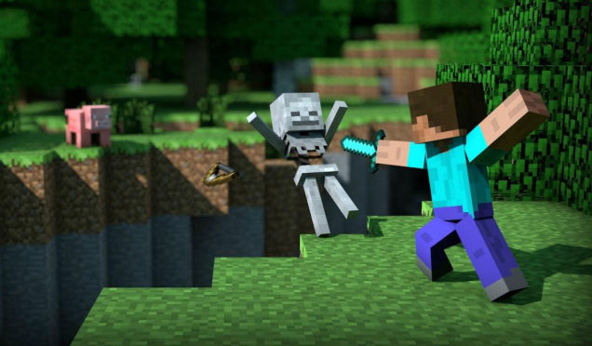
HACKING MINECRAFT

Slide 2
LET’S OVERCLOCK
sudo raspi-config
Change 7: Over clock 900Mhz at max
Change 8: Select memory share = 128MB

Slide 3
HACKING MINECRAFT
﻿In the LX Terminal:
sudo idle
Open a ‘new’ window
Type the code and click save
Save into the PI/Home folder
Pess F5 to save and run the code

Slide 4
Minecraft Trampoline
﻿
from mcpi import minecraft
mc = minecraft.Minecraft.create()
while True:
p = mc.player.getTilePos()
b = mc.getBlock(p.x,p.y-1,p.z) if b == 2: ###grass mc.player.setPos(p.x, p.y+20, p.z)
###+20 means 20 blocks up
Notes:
Bounces when on grass

Slide 5
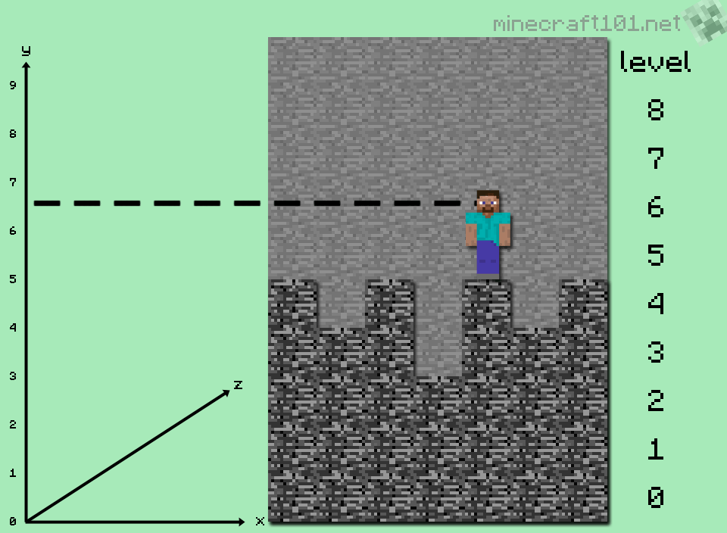
How High is the world?
from mcpi import minecraft
mc = minecraft.Minecraft.create()
y = mc.getHeight(0,0)
mc.postToChat("Height of the world is")
mc.postToChat(y)
Notes:
Finds the height of your world

Slide 6
Hide a Diamond, Find a Diamond
from mcpi import minecraft
mc = minecraft.Minecraft.create()
from time import sleep
mc.postToChat("Here is the diamond block I have hidden.")
mc.setBlock(100, 25, 100, 57)
mc.camera.setFixed()
mc.camera.setPos(100, 30, 100)
sleep(10)
mc.postToChat("Go find it!")
mc.camera.setNormal()
Notes:
Hides a diamond in the game, shows you then you have to find it

Slide 7
Stalker!
Replace the last line with the line below and the camera follows you around the world
mc.camera.setFollow()
Notes:
Stalk the player

Slide 8
Force Field
import mcpi.minecraft as minecraft
import time
from mcpi import block
mc=minecraft.Minecraft.create()
def forcefield():
pos = mc.player.getPos()
mc.setBlocks(pos.x-3, pos.y, pos.z-3, pos.x+3, pos.y+3, pos.z+3, block.AIR)
while True:
pos = mc.player.getTilePos()
air = mc.getBlock(pos.x+1, pos.y+1, pos.z+1)
if air != block.AIR.id:
mc.postToChat ("Forcefield Active")
forcefield()
Notes:
Walk into a wall or hill and the force field protects you and removes the blocks

Slide 9
MIDAS TOUCH
from mcpi import minecraft
mc = minecraft.Minecraft.create()
Import time
gold = 41
water = 9
air = 0
while True:
pos = mc.player.getTilePos()
blockBelow = mc.getBlock(pos.x, pos.y - 1, pos.z)
if blockBelow != air and blockBelow != water:
mc.setBlock(pos.x, pos.y -1, pos.z, gold)
time.sleep(0.1)
Notes:
Turn everything to Gold!

Slide 10
Rainbow Road
import mcpi.minecraft as minecraft
import mcpi.block as block
import random
import time
mc = minecraft.Minecraft.create()
pos = mc.player.getPos()
def SetRoad():
pos = mc.player.getPos()
mc.setBlock(pos.x, pos.y-1, pos.z, 35,1)#orange
mc.setBlock(pos.x-1, pos.y-1, pos.z, 35,2)#pinky
mc.setBlock(pos.x-2, pos.y-1, pos.z, 35,3)#sky blue
mc.setBlock(pos.x-3, pos.y-1, pos.z, 35,4)#yellow
mc.setBlock(pos.x-4, pos.y-1, pos.z, 35,5)#green
mc.setBlock(pos.x-5, pos.y-1, pos.z, 35,6)#pink
mc.setBlock(pos.x-8, pos.y-1, pos.z, 35,9)#blue
mc.setBlock(pos.x-9, pos.y-1, pos.z, 35,10)#purple
while True:
SetRoad()
time.sleep(0.05)
Notes:
Walk around and create a rainbow road

Slide 11
Rainbow Disco
import mcpi.minecraft as minecraft
import mcpi.block as block
import random
import time
mc = minecraft.Minecraft.create()
pos = mc.player.getPos()
def SetRoad():
colour = random.randint(1,11)
pos = mc.player.getPos()
mc.setBlock(pos.x, pos.y-1, pos.z, 35,colour)#random
while True:
SetRoad()
time.sleep(0.05)
Notes:
Now it is a Disco

Slide 12
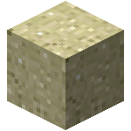
Minecraft: Drop some Sand 1
from mcpi import minecraft
mc = minecraft.Minecraft.create()
pos = mc.player.getTilePos()
mc.setBlock(pos.x, pos.y + 25, pos.z, 13)
Add a while True statement
Notes:
Drop sand blocks from the sky

Slide 13
Minecraft: Drop some Sand 2
from mcpi import minecraft
mc = minecraft.Minecraft.create()
from time import sleep
pos = mc.player.getTilePos()
while mc.getBlock(pos.x, pos.y, pos.z) != 13:
mc.setBlock(pos.x, pos.y + 25, pos.z, 13)
sleep(1)
pos = mc.player.getTilePos()
mc.postToChat("Got you!")
Notes:
Make it into a game, dodge the sand, don’t get caught!

Slide 14
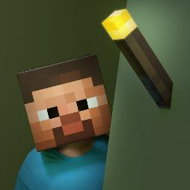
Torches
from mcpi import minecraft
from mcpi import block
mc = minecraft.Minecraft.create()
pos = mc.player.getTilePos()
mc.setBlock(pos.x, pos.y + 2, pos.z, block.STONE)
# create torches
# on top mc.setBlock(pos.x, pos.y + 3, pos.z, block.TORCH)
# to the east mc.setBlock(pos.x + 1, pos.y + 2, pos.z, block.TORCH)
# to the west mc.setBlock(pos.x - 1, pos.y + 2, pos.z, block.TORCH)
# to the north mc.setBlock(pos.x, pos.y + 2, pos.z - 1, block.TORCH)
# to the south mc.setBlock(pos.x, pos.y + 2, pos.z + 1, block.TORCH)
Notes:
Create a block of torches!

Slide 15
Cover my World
from mcpi import minecraft
mc = minecraft.Minecraft.create()
while True:
pos = mc.player.getTilePos()
for x in range(pos.x, pos.x + 10):
for z in range(pos.z, pos.z + 10):
y = mc.getHeight(x,z)
mc.setBlock(x, y, z, 78)
Notes:
Flood the world around you

Slide 16
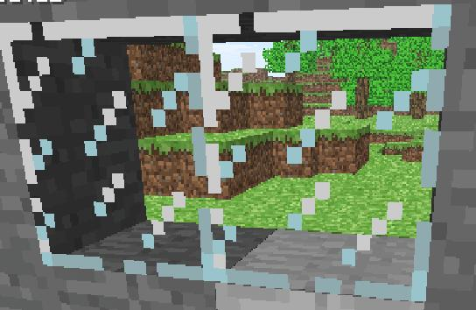
Build A Glass Bridge
from mcpi import minecraft
mc = minecraft.Minecraft.create()
from mcpi import block
import time
while True:
myX, myY, myZ = mc.player.getTilePos() #find out where we are
mc.setBlocks(myX - 1, myY - 1, myZ - 1, myX + 1,myY -1, myZ +1,block.GLASS)
time.sleep(0.1) # Add a 0.1 second delay
What happens if you change the GLASS to AIR?
Remove the last myY -1
Notes:
Create a glass bridge wherever you walk.

Slide 17
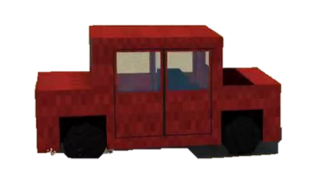
Are we there yet?
from mcpi import minecraft
from math import sqrt
from time import sleep
mc = minecraft.Minecraft.create()
startPos = mc.player.getTilePos()
while True:
posNow = mc.player.getTilePos()
xDiff = startPos.x - posNow.x
yDiff = startPos.y - posNow.y
zDiff = startPos.z - posNow.z
xSquare = xDiff * xDiff
ySquare = yDiff * yDiff
zSquare = zDiff * zDiff
total = xSquare + ySquare + zSquare
distance = sqrt(total)
mc.postToChat(distance)
sleep(1)
Notes:
Measure the distance that you have moved from your starting point, use it to find your way home.

Slide 18
Finding some Treasure
from mcpi import minecraft
mc = minecraft.Minecraft.create()
import time
treasureList = [14,15,16,41,42,49,73,89,56,57] #The block ID for Gold Ore, Diamond Ore, etc...
while True: # A loop to keep checking
playerx, playery, playerz = mc.player.getTilePos() # Find out where you are
for i in range (0,50): # build a loop to check the 50 blocks below you
blocktype = mc.getBlock(playerx, playery -i, playerz) #find the block
if blocktype in treasureList: # check if the block ID is in the treasureList
mc.postToChat("We've found treasure!")
time.sleep(0.01) #Only check every 100th of a second - otherwise our pi will freeze...
Notes:
Treasure detector, activities if you are above treasure

Slide 19
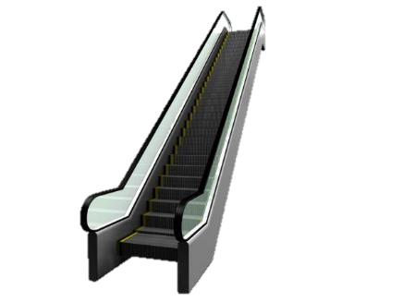
Minecraft Escalator
import mcpi.minecraft as minecraft
import mcpi.block as block
import time
LineColour = 46
mc = minecraft.Minecraft.create()
def Main():
x,y,z = mc.player.getPos()
CurrentBlock = mc.getBlock(x,y-1,z)
if CurrentBlock == 46 & mc.getBlock(x,y-1,z-1)== 46:
mc.player.setPos(x,y,z-1)
elif CurrentBlock == 46 & mc.getBlock(x+1,y-1,z)== 46:
mc.player.setPos(x+1,y,z)
elif CurrentBlock == 2 & mc.getBlock(x,y-1,z+1)== 2:
mc.player.setPos(x,y,z+1)
elif CurrentBlock == 2 & mc.getBlock(x-1,y-1,z)== 2:
mc.player.setPos(x-1,y,z)
while True:
Main() Lay down some TNT at right angles and it will follow it
Notes:
Place blocks of TNT, go back to the first block, run the code, you travel along like an escalator!

Slide 20
Minecraft Instant Messenger Part 1
import time
import random
import mcpi.minecraft as minecraft
import mcpi.block as block
mc = minecraft.Minecraft.create()
global TempList
def letterI(): ###This creates the letter I
row1 = (35, 35, 46, 46, 46, 35, 35)
row2 = (35, 35, 35, 46, 35, 35, 35)
row3 = (35, 35, 35, 46, 35, 35, 35)
row4 = (35, 35, 35, 46, 35, 35, 35)
row5 = (35, 35, 46, 46, 46, 35, 35)
Templist = [row1,row2,row3,row4,row5]
return Templist
Notes:
Build a messaging service in MC.

Slide 21
Minecraft Instant Messenger Part 2
def PrintWall(ImportedList):
pos = mc.player.getTilePos()
mc.player.setPos(pos.x,pos.y,pos.z)
mylist = ImportedList
for row in range (0,5):
for column in range (0,6):
mc.setBlock(pos.x+column, pos.y+row, pos.z-20, mylist[row][column])
while True:
PrintWall(letterI())
time.sleep(0.3)
Now create other letters and add them underneath the Letter I, use this to build up words.
Create a variable to allow he user to type in a word and the Minecraft prints it
Notes:
Part two of the IM

Slide 22
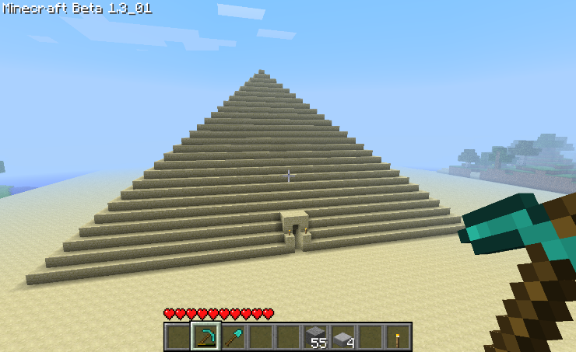
Can you create a Pyramid?

Slide 23
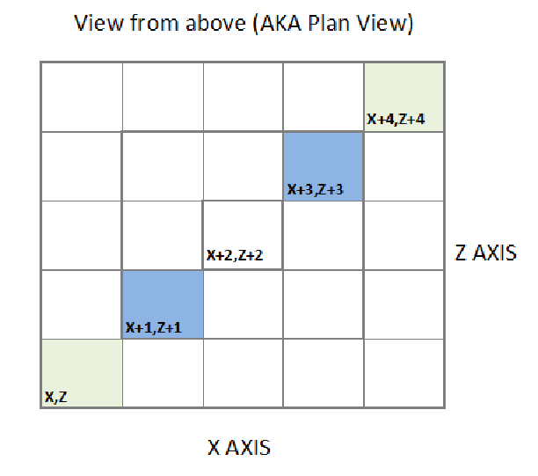
Pyramid

Slide 24
1. Pyramid Prep
﻿import sys
import math sys.path.append("./mcpi/api/python/mcpi") ( if using old version of Raspberry Pi)
import minecraft as minecraft (use if using new version of Raspberry Pi)
import minecraft﻿
mc = minecraft.Minecraft.create()
# Import specific Minecraft libraries
import minecraft as minecraft
import block as block
# Block definitions
AIR = 0
DIRT = 3
SAND = 12
SANDSTONE = 24
GOLD = 41

Slide 25
2. Pyramid Math
def CreatePyramid(posx,posy,posz,width,mybase,mywalls,mytopblock): # Function to create a pyramid at x,y,z with specified width using block materials for the base, walls and top.
mc.postToChat("About to create pyramid!")
if width%2==0: # May sure width is odd number so pyramid ends, with a single block
width=width+1
height = (width+1)/2
halfsize = int(math.floor(width/2))
# Create base for pyramid
mc.setBlocks(posx-halfsize-2,posy-2,posz-halfsize-2,posx+halfsize+2,posy- 2,posz+halfsize+2,DIRT)
mc.setBlocks(posx-halfsize-2,posy-1,posz-halfsize-2,posx+halfsize+2,posy- 1,posz+halfsize+2,mybase)

Slide 26
3. Pyramid Math
# Create solid Pyramid
for y in range(posy,posy+height):
mc.setBlocks(posx-halfsize,y,posz-halfsize,posx+halfsize,y,posz+halfsize,mywalls)
halfsize = halfsize-1
# Change top block
print "Set top block"
mc.setBlock(posx,posy+height-1,posz,mytopblock)
print "Position player on top"
mc.player.setPos(posx,posy+height,posz)

Slide 27
Create that Pyramid
def CreatePyramid(posx,posy,posz,width,mybase,mywalls,mytopblock):
# Function to create a pyramid at x,y,z with specified width using block materials for the base, walls and top
CreatePyramid(0,1,0,51,SANDSTONE,SANDSTONE,GOLD)

Slide 28
Volcano
﻿import minecraft as minecraft, block,time,random
mc = minecraft.Minecraft.create()
layers = 10 # How high our volcano is going to be
vec = (0,0,0) # the starting point for our volcano
mc.setBlocks(0,0,0,100,100,100,block.AIR) # let's make some space for our volcano
for layer in range(0,layers): # Build the volcano
mc.setBlocks(layer + vec[0],layer + vec[1],layer + vec[2],vec[0] + (2*layers)-layer,vec[1] + layer,vec[2] + (2*layers)-layer,block.STONE)
time.sleep(1)
count = 0
while count < (layers*layers*3): # Add some random blocks on the top to make it look a bit more real
x = random.randint(vec[0],vec[0]+(2*layers)+1)
z = random.randint(vec[2],vec[2]+(2*layers)+1)
mc.setBlock(x,layers+10,z,block.GRAVEL)
time.sleep(0.01)
count+=1
while True: # Get the lava flowing!
mc.setBlocks(vec[0]+int(layers)-1,vec[1]+layers,layers-1,vec[0]+int(layers),vec[1]+layers,layers+1,block.LAVA_FLOWING) # This is not a new line!
time.sleep(1)

